Slide 1






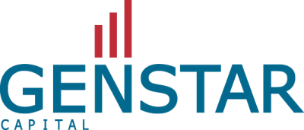

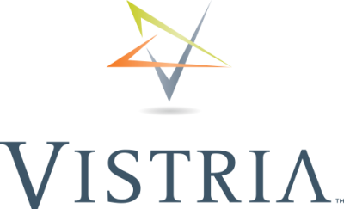











PE Pulse
Instant fund intelligence
Select a Fund Manager
Select a topic
Also explore the interactive fund performance comparison dashboard - PE Pulse Live
25+ fund managers covered, and growing!
Note: Enable slideshow to interact with this tool
For more details, contact BCN PEG Staffing

Slide 2



Altaris (Aug 2024): Fund manager overview
Altaris is a mid-market PE fund focused on buyout and growth equity
investments in healthcare, pharma and life sciences segments
Summary
preliminary
FOUNDED |  | TEAM SIZE |  | INDUSTRY AND GEO FOCUS
2003 1 office, located in New York City, NY |  | ~15 professionals as of June 2024 |  | Healthcare in the US With a focus on pharmaceuticals, medical devices, life sciences and diagnostics, and healthcare services
TOTAL CAPITAL RAISED |  | AUM |  | AVERAGE DEAL SIZE (typical amount of capital invested per deal)
~$8.6B as of June 2024 |  | ~$9.4B as of June 2024 |  | ~$300-400M* Source: Pitchbook
PORTFOLIO |  | FUND METRICS |  | AVERAGE INVESTMENT TERM
~140 Total investments (43 platform investments that have completed ~100 add-on acquisitions) | 13 Active investments | 10 buyout, 1 co-investment Closed Altaris Health Partners VI fund in 2024 ~$3.5B capital commitments | Avg. IRR: 23%** Source: Pitchbook | ~5-6 years Source: Pitchbook
Note: (*) Based on the data of ~15 current / past portfolio companies; (**) Average IRR calculated based on available data for 7 funds |Source: S&P Capital IQ, Pitchbook, Company website, LinkedIn, Lit. search

Slide 3
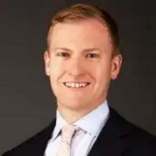
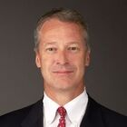
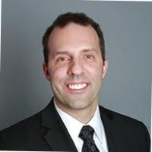
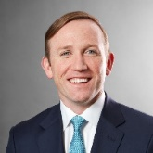
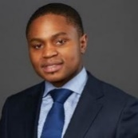
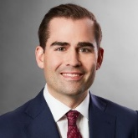
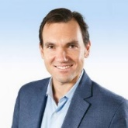
Altaris (Aug 2024): Key leadership
George Aitken-Davies and Daniel Tully founded Altaris in 2003
leadership
preliminary
Founding members (2003)
George Aitken-Davies Co Founder and MD | Daniel Tully Co Founder and MD | Charles Mullens CFO and COO | Jim O’Brien MD, Medical Devices | Garikai Nyaruwata MD, Pharmaceuticals | Nicholas Fulco MD, Healthcare Services | Rafael Torres MD, Life Sciences and Diagnostics
Co-founded in 2003 | Co-founded in 2003 | Joined in 2017 | Joined in 2010 | Joined in 2015 | Joined in 2018 | Joined in 2021
Professional Background
Prior to Altaris, worked at Merrill Lynch, holding various positions in the private equity and healthcare investment banking divisions Also serves as a Trustee, Children’s Hospital of Philadelphia and the Senator Foundation | Previously worked at Merrill Lynch, holding various positions in the investment and investment banking divisions, including serving as global head of healthcare equity capital markets Also served as Vice Chairman, Hospital for Special Surgery (New York) | Before Altaris, worked as Director of Fund Reporting at J.C. Flowers & Co. (member of the Compliance Committee; Nov ’09 – Mar ‘17) and Deloitte (serving domestic and international asset management clients; Sep ’00 – Oct ’09) Avg. career tenure: ~25 years | Prior to Altaris, worked at Merrill Lynch as a member of the investment banking and equity capital markets groups, focused on the execution of mergers, acquisitions and corporate finance transactions (Jul ’06 – Jul ’10) Avg. career tenure: ~20 years | Previously worked in the private equity and healthcare practices as an Engagement Manager of McKinsey & Company, focusing on numerous transaction and corporate strategy engagements (Sep ’11 – Sep ’15) Avg. career tenure: ~15 years | Prior to Altaris, worked at CCMP Capital Advisors, focused on buyout and growth equity investments in the Healthcare and Consumer/Retail sectors (Sep ’10 – Apr ’18) Also worked briefly at Travelers (commercial accounts; Jan ’09 – Sep ‘10) Avg. career tenure: ~15 years | Before Altaris, was the Head of Corporate Development & Strategy at Varian Medical Systems (May ’15 – May ’21) Also worked for GE, heading the healthcare vertical of its VC / PE arm (Jun ’06 – May ’15); previously a consultant at BCG (Oct 00-Aug ’01) Avg. career tenure: ~30 years
Altaris’ leadership team includes experienced professionals (avg. career tenure of ~20 years) with rich private equity/investment banking experience in the healthcare sector
Note: Only includes Founders, MDs, and COO; Professional background data and average career tenure calculated based on information availability
Source: Company website, Lit. search; LinkedIn
Legend:
Healthcare exp.
VC/PE/IB exp.
Consulting exp.

Slide 4
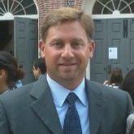
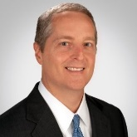
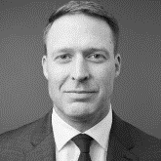
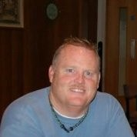
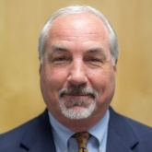
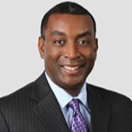
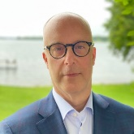
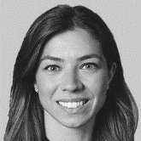
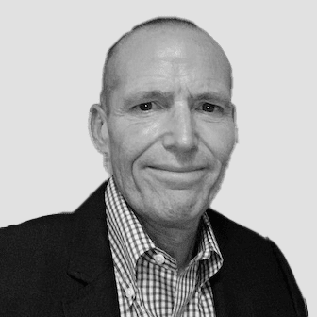
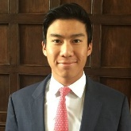
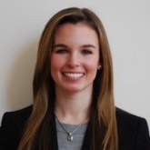
Altaris (Aug 2024): Investment team
Key investment professionals
Investment team
Not exhaustive
Leadership
Operating partners and VPs
George Aitken-Davies
Co-Founder and Managing Director
Daniel Tully
Co-Founder and Managing Director
Iain Baird
Board Member at Padagis and Kindeva
Tim Callahan
Board Member at CMP Pharma and Padagis
Nicholas Fulco
Managing Director, Healthcare Services
Aron Bell
Head of Portfolio Engagement
Shawn Cavanagh
Executive Chair at Kindeva and Veranova
Bernard Lyons
Board Member at Minnetronix
Garikai Nyaruwata
Managing Director, Pharmaceuticals
Jim O’Brien
Managing Director, Medical Devices
Philip Smith
Chair of Board of Intricon and Board member at Trean
Brooks West
Ex President and CEO at BK Medical
Rafael Torres
Managing Director, Life Sciences and Diagnostics
Lana Dweik
Head of Capital Market
Greg Sargen
Chair of Audit committee at Kindeva and Veranova
Myles Tang
Vice President
Melanie Boyle
Vice President
Source: Company website, Lit. search, LinkedIn

Slide 5
Altaris (Aug 2024): Fund performance
Altaris Health Partners IV fund has provided ~28% IRR closely followed by
AHP III and ACP IV with ~27% and ~26% IRR respectively
Fund performance
preliminary
Total Value to Paid-In Multiple (“TVPI”)
(Market Value + Distributions ) / Contributions
The TVPI is a metric used to assess performance of a fund and may be considered the net counterpart to MOIC.
Similar to MOIC, TVPI reflects the total capital generated compared to the total capital invested. This measurement is a simplified means of measuring the value created by a fund, without consideration for time. The calculation is net of fees and expenses.
Unlike MOIC, which can be calculated for both individual portfolio companies and the total fund, TVPI can only be calculated for an aggregated fund.
      Fund IRR returns (in %) and performance metrics by vintage
      30.0%
      20.0%
      10.0%
Data unavailable
      0.0%
      Altaris Health Partners I
      Altaris Health Partners II
      Altaris Health Partners III
      Altaris Constellation Partners
      Altaris Constellation Partners IV
      Altaris Health Partners IV
      Altaris Health Partners V
      Altaris Health Partners VI
      Vintage
      2003
      2008
      2014
      2017
      2018
      2018
      2021
      2024
      Fund size
      $0.4B
      $0.4B
      $0.5B
      $0.2B
      $0.2B
      $1.1B
      $2.4B
      $3.5B
      TVPI
      2.4x
      2.4x
      2.5x
      2.9x
      1.9x
      1.9x
      1.3x
      -
  TVPI shown instead due to non-availability of MOIC
Coloring based on IRR quartile ranking of respective funds
1st
2nd
3rd
4th
Source: Pitchbook

Slide 6
Altaris (Aug 2024): Key events
overall_1_132415434197746346 columns_1_132415434197746346 4_0_132417530214367334
Altaris has had a robust acquisitions / divestments pipeline over the years,
and it has increased its capital financing activities in the last 10 years
Key events
Non-Exhaustive
2003-2010
2003: Raised ~$350M for its first fund
2008: Raised ~$415M for Altaris Health Partners II fund from investors
2011-2015
2014: Raised ~$510M for Altaris Health Partners III fund
2016-2020
2017: Raised ~$165M for Altaris Constellation Partners
2018: Raised ~$1.1B for Altaris Health Partners IV
2018: Raised ~$240M for Altaris Constellation Partners IV
2021-2024 YTD
2021: Raised ~$2.4B for Altaris Health Partners V
2021: Raised ~$20M for Altaris Padagis Co-Invest
2024: Raised ~$3.5B for Altaris Health Partners VI fund
Fund raising
Major Investments
2004: Invested in JDS Pharma for ~$60M
2005: Invested in Paragon Medical for ~$25M
2006: Acquired U.S. Health Works for ~$185M
2012: Invested in CMP Pharma
2014: Acquired Healthtronics for ~$130M
2016: Invested in Senior Helpers for ~$125M (majority stake in partnership with Audax Group)
2018: Acquired Analogic for ~$1.1B
2020: Invested in Kindeva Drug Delivery for ~$650M (majority stake in partnership with Monroe Capital)
2021: Acquired Padagis for ~$1.5B
2022: Acquired Intricon for ~$250M
2024: Acquired Sharecare for ~$520M
Major
Divestments
2007: Divested JDS Pharma for ~$125M
2009: Divested Endocare for ~$15M
2014: Divested Sparta Systems for ~$370M
2015: Divested Precyse for ~$275M
2017: Divested Quantum Health for ~$220M
2019: Divested AGS Health for ~$320M
2021: Divested Paramit for ~$1B
2021: Divested Senior Helpers for ~$190B
2022: Divested Tivity Health for ~$3.2B
Note: Acquired refers to acquisition of 100% stake; information on stake in major investment / divestment captured basis data availability
Source: Pitchbook, Lit. search
Healthcare Services
Medical devices
Pharmaceuticals
Life Sciences

Slide 7
Altaris (Aug 2024): Fund overview
Since 2003, Altaris has raised ~$8.6B funds and grown to ~$10B AUM in 2024; Invested primarily in Healthcare Services followed by Medical devices and Pharma.
History and overview
preliminary
Healthcare services primary focus followed by Med. devices and pharma
Fund size has grown multi-fold post 2018
AUM almost doubled in the year 2024
platforms only
  Cumulative fund raised - $8.6B (as of June 2024)
  Primarily driven by closing of AHP VI funding (~$3.5B) in 2024
  Mainly includes healthcare staffing solutions and HC packaging providers
  AHP: Altaris Health Partners
  ACP: Altaris Constellation Partners
Source: PitchBook, Company website and Lit. search

Slide 8



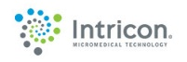
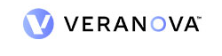


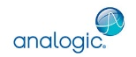

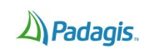
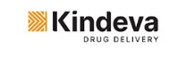


Altaris (Aug 2024): Current portfolio
Altaris Capital’s current portfolio composition and key logos
Current portfolio
Key logos
preliminary
Source: PitchBook, Company website and Lit. search

Slide 9

Vistria (Sep 2024): Fund manager overview
Vistria is a middle-market PE fund focused on buyout, recapitalization and
growth equity investments in healthcare, education, and financial services sectors
History and overview
preliminary
FOUNDED |  | TEAM SIZE |  | INDUSTRY AND GEO FOCUS
2013 3 offices located in Chicago, Dallas, and New York City |  | ~100 professionals as of June 2024 |  | Healthcare and Education in the US With a focus on healthcare services (~45% of platform investments) and knowledge & learning solutions (~30%)
TOTAL CAPITAL RAISED |  | AUM |  | AVERAGE DEAL SIZE (typical amount of capital invested per deal)
~$8.2B as of June 2024 |  | ~$13B as of July 2024 |  | ~$50-500M Source: Preqin
PORTFOLIO |  | FUND METRICS |  | AVERAGE INVESTMENT TERM
~100 Total investments (45 platform investments that have completed ~60 add-on acquisitions) | 35 Active investments | 5 Buyouts, 2 Co-investments, 1 Structured Credit, 1 Real-Estate | Avg. IRR: 13%** Source: Pitchbook | ~2-6 years Source: Preqin
Note: (*) Based on the data of ~15 current / past portfolio companies; (**) Average IRR calculated based on flagship buyout equity funds
Source: S&P Capital IQ, Pitchbook, Preqin, Company website, LinkedIn, Lit. search

Slide 10
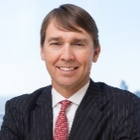
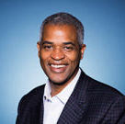
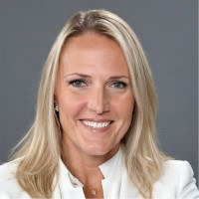
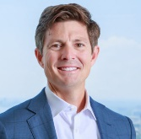
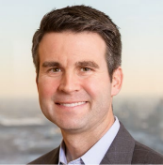
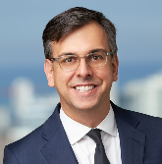
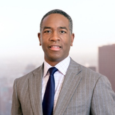
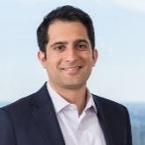
Vistria (Sep 2024): Key leadership
Kip Kirkpatrick and Marty Nesbitt founded Vistria in 2013
leadership
preliminary
Founding partners (2013)
Senior Partner and Co-head
Kip Kirkpatrick Senior Partner, Co-Chairman & Co-CEO | Marty Nesbitt Senior Partner, Co-Chairman & Co-CEO | Amy Christensen Healthcare | David Schuppan Healthcare | Michael Castleforte Financial Services | Boris Rapoport Financial Services | Philip Alphonse Knowledge & Learning | Adnan Nisar Knowledge & Learning
Co-founded in 2013 | Co-founded in 2013 | Joined in 2013 | Joined in 2017 | Joined in 2013 | Joined in 2021 | Joined in 2013 | Joined in 2013
Professional Background
Prior to Vistria, co-founded two private equity firms - One Equity Partners (2001) & Water Street Healthcare Partners (2005) Also served as CEO of United Shore Financial Services (Apr ’11 – May ’13) Avg. career tenure: ~30 years | Previously worked as President and CEO at TPS Parking Management (1998 – 2012) and Pritzker Realty Group Also served as Equity VP and Investment Manager of LaSalle Partners | Before Vistria, worked as VP of NewSpring Capital on a family of funds, including a dedicated HC fund (2011 – 2013) Also served as an invt. professional at CCP PE Partners (May ’07 – Jul ‘09); Healthcare consultant at Huron Consulting (2004-2007) Avg. career tenure: ~20 years | Prior to Vistria, founded and served as Partner of Cressey & Company with a focus on HC tech (Nov ’07 – Sep ’16) Served as VP of Thoma Cressey Equity Partners, focusing on HC Services and Facilities (1998 – 2007) Avg. career tenure: ~25 years | Previously worked as General Counsel & Head of BD at USFS, focusing on systematic risk management (2011 – 2013) Also served as Corporate Attorney of Winston & Strawn (2007 – 2011) Avg. career tenure: ~20 years | Before Vistria, worked as Managing Director and Member of the Invt. Committee at Lightyear Capital (Jun ’11 – Aug ’21) Served as Principal of FTV Capital (Jun ’03 – Jun ’11) & Invt. banker with WR Hambrecht + Co (Aug ‘00 – Jun ‘03) Avg. career tenure: ~25 years | Prior to Vistria, worked as Principal of Sterling Partners with ~$6.0B in AUM, focusing on investments in education companies (2002 – 2012) Served as Director for Educate, Educate Online, and Infilaw Holding | Previously worked as Senior Associate at Mubadala focusing on global investments in the real estate and healthcare sectors (Aug ’11 – Jul ’13) Also served as Associate at M3 Capital Partners LLC (Jul ’04 – Jan ’09) Avg. career tenure: ~20 years
Vistria’s leadership team includes experienced professionals (avg. career tenure of ~25 years) with rich private equity/investment banking experience across healthcare, financial services, and education sectors
Note: Only includes Co Founders & Senior Partners / Co-heads; Professional background data and average career tenure calculated based on information availability
Source: Company website, Lit. search; LinkedIn
Legend:
Healthcare exp.
VC/PE/IB exp.
Consulting exp.

Slide 11
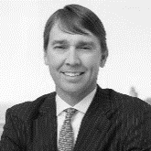
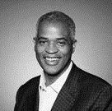

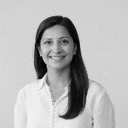
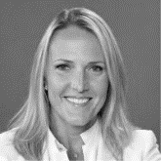

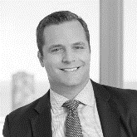
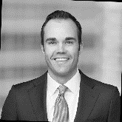
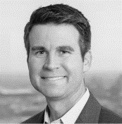
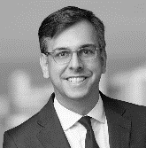

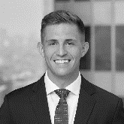
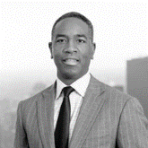
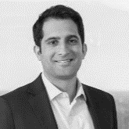
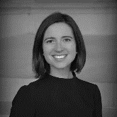
Vistria (Sep 2024): Investment team
Key investment professionals
Investment team
Not exhaustive
Leadership
Operating Partner, Director & VP (Healthcare focused)
Kip Kirkpatrick
Senior Partner, Co-Chairman & Co-CEO
Marty Nesbitt
Senior Partner, Co-Chairman & Co-CEO
Mo Yang
Partner, Healthcare
Natasha Latif
Partner, Healthcare
Amy Christensen
Senior Partner & Co-Head Of Healthcare
David Schuppan
Senior Partner & Co-Head Of Healthcare
Matthew Schulz
Partner, Healthcare
Max Vielmetti
Vice President, Healthcare
Michael Castleforte
Senior Partner & Co-Head Of Financial Services
Boris Rapoport
Senior Partner & Co-Head Of Financial Services
Robert Schill
Vice President, Healthcare
Shane Maloney
Vice President, Healthcare
Philip Alphonse
Senior Partner & Co-Head Of Knowledge & Learning
Adnan Nisar
Senior Partner & Co-Head Of Knowledge & Learning
Elizabeth Jurinka
Operating Director, Healthcare Policy, Vistria PRG
Note: Financial Services and Education OPs/VPs/Directors not shown in the RHS panel
Source: Company website, LinkedIn

Slide 12
Vistria (Sep 2024): Fund performance
Vistria II fund has provided strongest returns with ~30% IRR closely followed by Vistria Fund I with ~25% IRR
Fund performance
preliminary
Total Value to Paid-In Multiple (“TVPI”)
(Market Value + Distributions ) / Contributions
The TVPI is a metric used to assess performance of a fund and may be considered the net counterpart to MOIC.
Similar to MOIC, TVPI reflects the total capital generated compared to the total capital invested. This measurement is a simplified means of measuring the value created by a fund, without consideration for time. The calculation is net of fees and expenses.
Unlike MOIC, which can be calculated for both individual portfolio companies and the total fund, TVPI can only be calculated for an aggregated fund.
      Fund IRR returns (in %) and performance metrics by vintage
      30.0%
      20.0%
  Fund still open hence quartile details currently unavailable
      10.0%
      0.0%
      -10.0%
      Vistria Fund I
      Vistria Fund II
      Vistria Fund III
      Vistria Fund IV
      Vistria Structured Credit Fund I
      Vistria Fund V
      Vintage
      2015
      2017
      2021
      2021
      2023
      Open
  Raised $2B so far, with target of $4B
      Fund size
      $0.4B
      $0.9B
      $1.1B
      $2.7B
      $0.7B
      $2.0B
      TVPI
      2.4x
      2.1x
      1.3x
      1.1x
      1.1x
      1.0x
  TVPI shown instead due to non-availability of MOIC
Coloring based on quartile ranking of respective funds
1st
2nd
3rd
4th
Note: Does not include TVG Puma co-investment fund (raised ~$45M), Vistria housing fund (open) and Vistria SMA NYCRF co-investment fund (open)
Source: Pitchbook

Slide 13
Vistria (Sep 2024): Key events
overall_1_132415434197746346 columns_1_132415434197746346 4_0_132417530214367334
Vistria has had a robust acquisition / divestment pipeline, and it has increased
its capital financing activities in the last 5 years
Key events
Non-Exhaustive
2013-2020
2003: Co-founded by Kip Kirkpatrick and Marty Nesbitt in Chicago, IL
2015: Raised ~$400M for its first fund
2017: Raised ~$870M for Vistria Fund II
2021
Raised ~$1.1B for Vistria Fund III
Raised ~$2.7B for Vistria Fund IV
Expanded operations by opening an office in Dallas, TX
2022
Raised ~$45M for TVG Puma Co-Invest
Started raising funds for Vistria Fund V - ~$2B raised till date out of $4B target
Recognized as top investor in elder and disabled care sector by PitchBook
2023-2024 YTD
2023: Raised ~$715M for Vistria Structured Credit Fund I
2023: Recognized in Top 10 Firms Investing for Impact by New Private Markets
2023: Expanded operations by opening an office in New York, NY
Capital raise/ other major developments
Major Investments
2017: Invested in Apollo Education Group for ~$1.1B (majority stake in partnership*)
2018: Acquired Rock Dental
2020: Invested in Help at Home for ~$1.4B (majority stake in partnership with Centerbridge Partners)
Invested in SCA Pharma for ~$125M (majority stake in partnership with Excellere Partners)
Invested in Sleepdoctor (majority stake in partnership with Onex Falcon)
Acquired in BioCare SD
Invested in Pantherx Rare for ~$1.4B (majority stake in partnership with General Atlantic and Nautic Partners)
Invested in Sandstone Care for ~$250M (majority stake in partnership with Auxilium Partners)
Acquired Beacon for ~$300M
2023: Acquired MGT Consulting
2024: Invested in Soliant Health for ~$2.5B
2024: Invested in AnewHealth (minority stake)
Major
Divestments
2018: Divested Penn Foster
2020: Divested St. Croix for ~$350M
Divested Sevita for ~$1.4B
Divested Agape Care
2023: Divested BriteCap Financial (Fka ForwardLine) for ~$40M
2024: Divested HomeFree
Note: Acquired refers to acquisition of 100% stake; information on stake in major investment / divestment captured basis data availability;
(*) denotes partnership with The Najafi Companies, Pantheon International, and Apollo Global Management | Source: Pitchbook, Lit. search
Healthcare
Knowledge & Learning
Financial Services

Slide 14
Vistria (Sep 2024): Fund overview
Since 2015, Vistria has raised ~$8B funds and grown to ~$13B AUM in 2024; invested primarily in healthcare services, and knowledge and learning firms
History and overview
preliminary
Fundraising has witnessed consistent growth since 2015...
..with a similar trend observed in assets under management
Vistria primarily invests in healthcare services & knowledge/learning sectors
platforms only
  Cumulative fund raise of ~$8.2B (as of June 2024); majority of open fund raised amount coming from VF V - $2B raised so far, with target of $4B
Note: (*) Does not include TVG Puma co-investment fund (raised ~$45M); VF denotes flagship Vistria equity funds, VSC denotes Vistria structured capital fund, VHF denotes Vistria housing fund, VSN denotes Vistria SMA NYCRF co-investment fund; 2020 AUM figures unavailable on the public domain
Source: Pitchbook, Company website and Lit. search

Slide 15








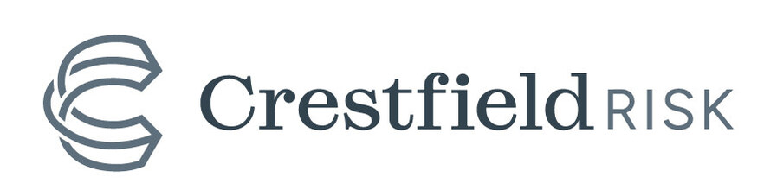


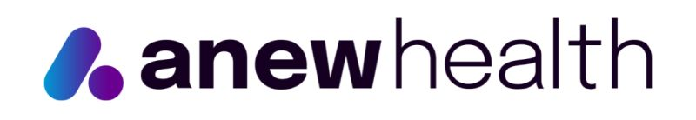
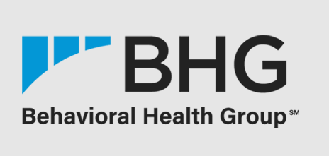






















Vistria (Sep 2024): Current portfolio
Vistria’s current portfolio composition and key logos
Current portfolio
Key logos
preliminary
Healthcare
Source: Pitchbook, Company website and Lit. search

